Slide 1

SQL CASE STUDY : GEMINI VS CHATGPT
Presented By : Aashish Raj

Slide 2
Introduction
Challenge
Your challenge is to craft SQL queries to extract insights from the Gemini Vs Chatgpt database.
Table Used
Models
Capabilities
Benchmarks

Slide 3
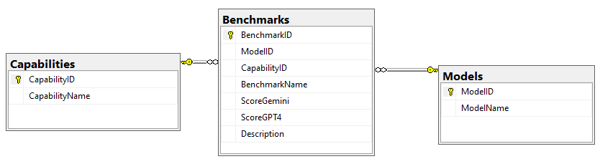
Table Schema

Slide 4
CASE STUDY QUESTIONS
What are the average scores for each capability on both the Gemini Ultra and GPT-4 models?
Which benchmarks does Gemini Ultra outperform GPT-4 in terms of scores?
What are the highest scores achieved by Gemini Ultra and GPT-4 for each benchmark in the Image capability?
Calculate the percentage improvement of Gemini Ultra over GPT-4 for each benchmark?
Retrieve the benchmarks where both models scored above the average for their respective models?
Which benchmarks show that Gemini Ultra is expected to outperform GPT-4 based on the next score?
Classify benchmarks into performance categories based on score ranges?
Retrieve the rankings for each capability based on Gemini Ultra scores?
Convert the Capability and Benchmark names to uppercase?
Can you provide the benchmarks along with their descriptions in a concatenated format?

Slide 5
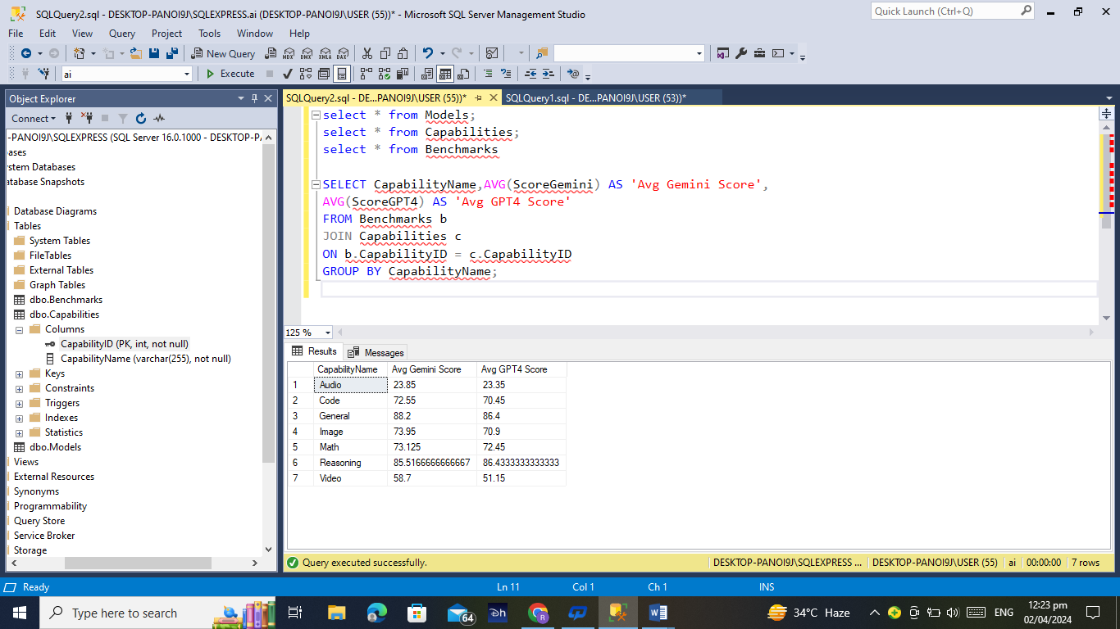
1
What are the average scores for each capability on both the Gemini Ultra and GPT-4 models?
Solution
SELECT CapabilityName, AVG(ScoreGemini) AS 'Avg Gemini Score',
AVG(ScoreGPT4) AS 'Avg GPT4 Score'
FROM Benchmarks b
JOIN Capabilities c
ON b.CapabilityID = c.CapabilityID
GROUP BY CapabilityName;

Slide 6
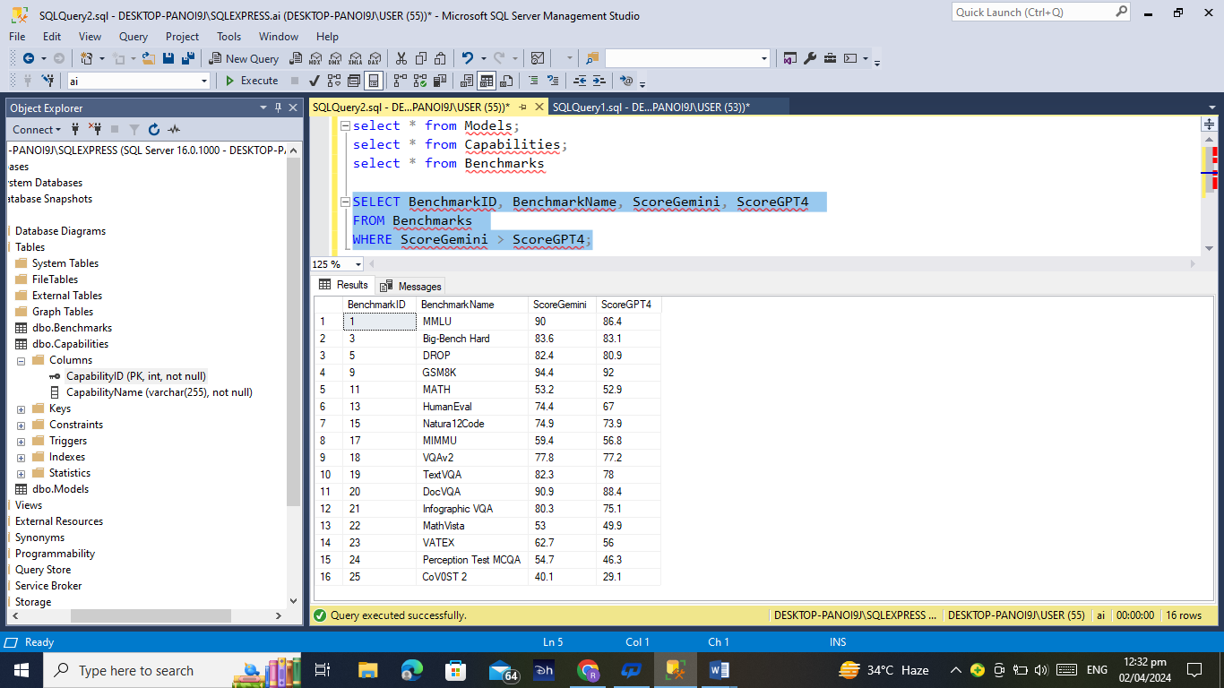
2
Which benchmarks does Gemini Ultra outperform GPT-4 in terms of scores?
Solution
SELECT BenchmarkID, BenchmarkName, ScoreGemini, ScoreGPT4
FROM Benchmarks
WHERE ScoreGemini > ScoreGPT4;

Slide 7
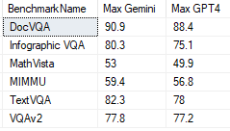
3
What are the highest scores achieved by Gemini Ultra and GPT-4 for each benchmark in the Image capability?
Solution
SELECT BenchmarkName, MAX(ScoreGemini) AS 'Max Gemini', MAX(ScoreGPT4) AS 'Max GPT4'
FROM Benchmarks b
JOIN Capabilities c
ON b.CapabilityID = c.CapabilityID
WHERE CapabilityName ='image'
GROUP BY BenchmarkName;

Slide 8
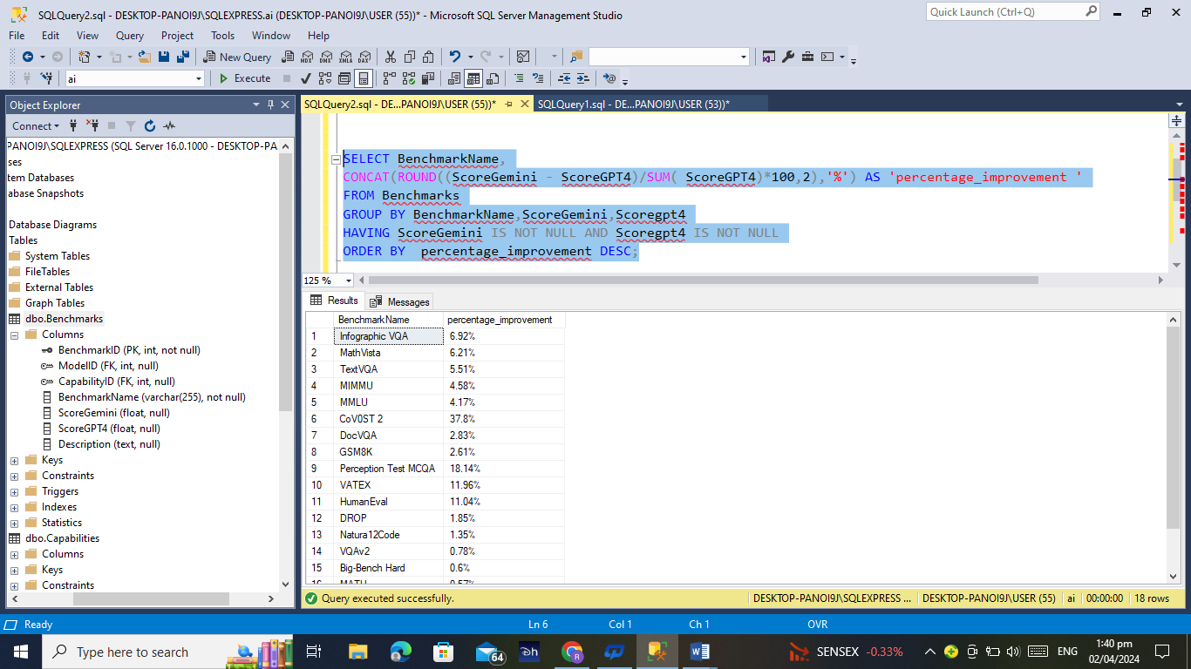
4
Calculate the percentage improvement of Gemini Ultra over GPT-4 for each benchmark?
Solution
SELECT BenchmarkName,
CONCAT(ROUND((ScoreGemini - ScoreGPT4)/SUM( ScoreGPT4)*100,2),'%') AS'percentage_improvement '
FROM Benchmarks
GROUP BY BenchmarkName,ScoreGemini,Scoregpt4
HAVING ScoreGemini IS NOT NULL AND Scoregpt4 IS NOT NULL
ORDER BY percentage_improvement DESC;

Slide 9
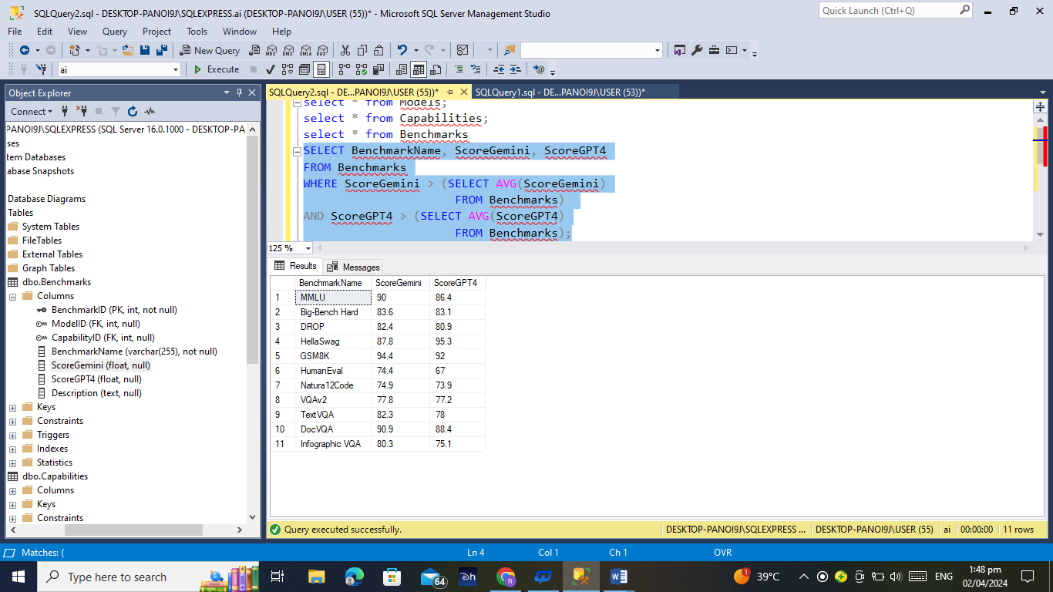
5
Retrieve the benchmarks where both models scored above the average for their respective models?
Solution
SELECT BenchmarkName, ScoreGemini, ScoreGPT4
FROM Benchmarks
WHERE ScoreGemini > (SELECT AVG(ScoreGemini)
FROM Benchmarks)
AND ScoreGPT4 > (SELECT AVG(ScoreGPT4)
FROM Benchmarks);

Slide 10
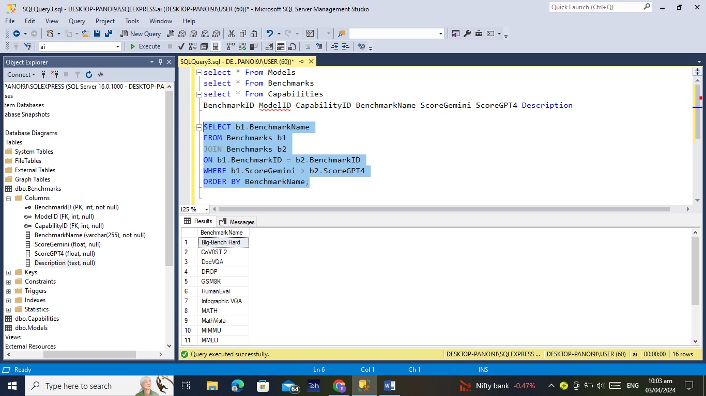
6
Which benchmarks show that Gemini Ultra is expected to outperform GPT-4 based on the next score?
Solution
SELECT b1.BenchmarkName
FROM Benchmarks b1
JOIN Benchmarks b2
ON b1.BenchmarkID = b2.BenchmarkID
WHERE b1.ScoreGemini > b2.ScoreGPT4
ORDER BY BenchmarkName;

Slide 11
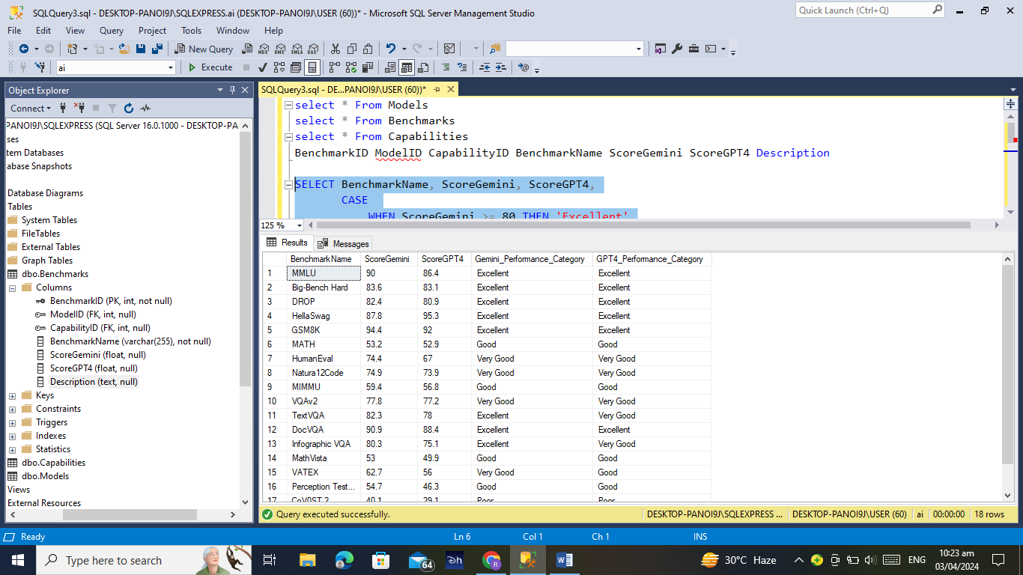
7
Classify benchmarks into performance categories based on score ranges?
Solution
SELECT BenchmarkName, ScoreGemini, ScoreGPT4,
CASE
WHEN ScoreGemini >= 80 THEN 'Excellent'
WHEN ScoreGemini >= 60 THEN 'Very Good'
WHEN ScoreGemini >= 45 THEN 'Good'
ELSE 'Poor'
END AS Gemini_Performance_Category,
CASE
WHEN ScoreGPT4 >= 80 THEN 'Excellent'
WHEN ScoreGPT4 >= 60 THEN 'Very Good'
WHEN ScoreGPT4 >= 45 THEN 'Good'
ELSE 'Poor'
END AS GPT4_Performance_Category
FROM Benchmarks
WHERE ScoreGPT4 IS NOT NULL;

Slide 12
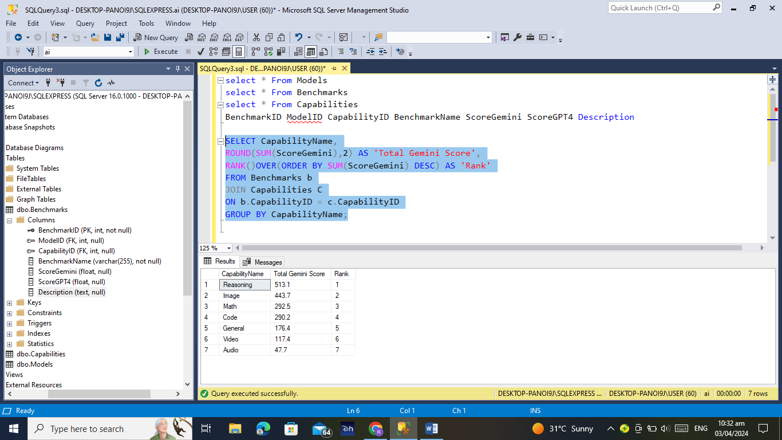
8
Retrieve the rankings for each capability based on Gemini Ultra scores?
Solution
SELECT CapabilityName,
ROUND(SUM(ScoreGemini),2) AS 'Total Gemini Score',
RANK()OVER(ORDER BY SUM(ScoreGemini) DESC) AS 'Rank'
FROM Benchmarks b
JOIN Capabilities c
ON b.CapabilityID = c.CapabilityID
GROUP BY CapabilityName;

Slide 13
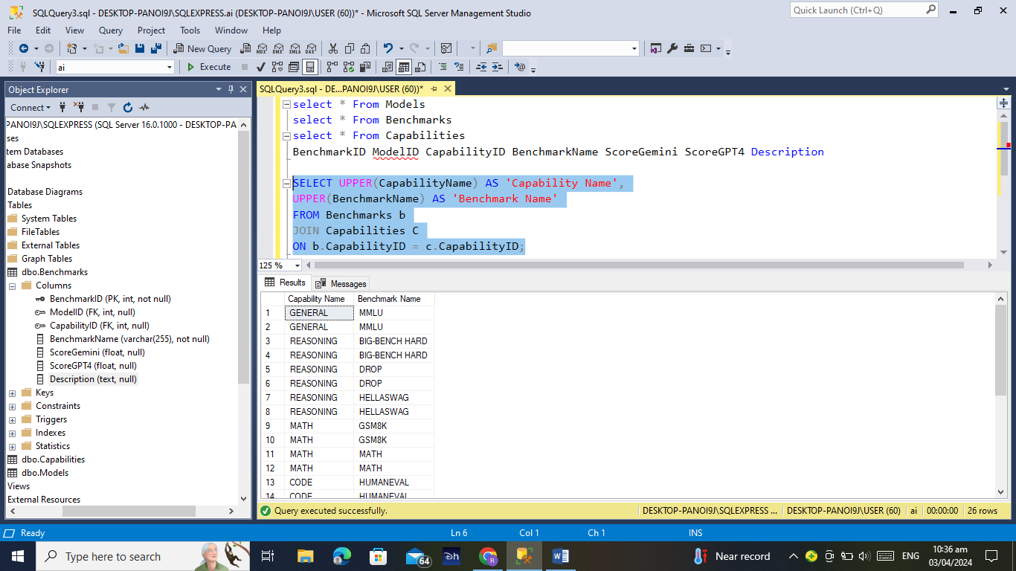
9
Convert the Capability and Benchmark names to uppercase?
Solution
SELECT UPPER(CapabilityName) AS 'Capability Name',
UPPER(BenchmarkName) AS 'Benchmark Name'
FROM Benchmarks b
JOIN Capabilities C
ON b.CapabilityID = c.CapabilityID;

Slide 14
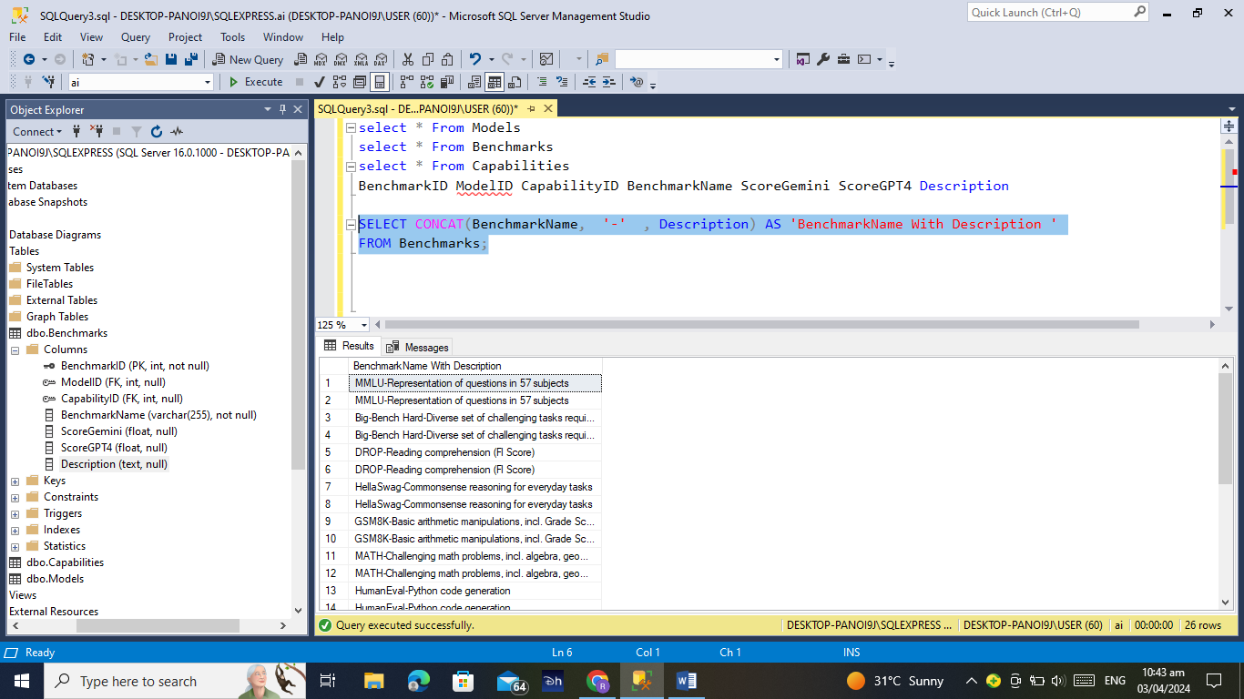
10
Can you provide the benchmarks along with their descriptions in a concatenated format?
Solution
SELECT CONCAT(BenchmarkName, '-' , Description) AS
'BenchmarkName With Description '
FROM Benchmarks;

Slide 15


